Slide 1
Design specification for manufacturability of PCB/PCBA
SMT Teams:Ben/Miles/John
2018-05-12

Slide 2
PCB Design Guideline

Slide 3
Revision record
Rev. | Date | Change Description
1.0 | 2016/12/20 | New release
1.1 | 2018/05/02 | Add Dip design specification

Slide 4
Purpose
Based on the requirements of production process , In the layout and circuit board design process , There is a standard to follow , To achieve high efficiency in the production of assembly , Easy assembly, low cost, and high quality target.
The content is only applicable to the related database, some are for reference only .

Slide 5
content
PCB layout rules
Text marking for silkscreen layer
PCB Fiducial Mark design
PCB fixed position hole
SMT component PAD design
PTH component PAD design
Through-hole(Via)design
Trace design
other limitation

Slide 6
PCB layout rules
V-Cut layout rule :
  Chips to V-Cut line should be more than 1mm, otherwise will damage chips or will change to use Stamp Cut design , will add the PCB cost
  The distance to PCB edge 0.5mm, can not layout the trace, The distance to PCB edge 1.0mm,can not layout the any component
  The distance to PCB edge 5mm, can not layout the components height over 25mm, otherwise cuter will damage components
Chips
≥1mm
≥1mm
Chips
V-CUT
De-panel Cuter
PCB V-CUT PCB
5cmm
25mm

Slide 7
PCB layout rules
V-Cut layout rules :
  PCB trace to V-Cut should be more then S=0.5mm safety buffer, otherwise will have the risk to damage the trace.
  When we use V-Cut
    PCB thickness 1.0mm to 3mm(1.0mm to 0.5mm + SMT pallet)
    PCB outline is square type or rectangle type, irregular shape can not use the V-Cut
S
T
H
Stamp Cut
irregular shape

Slide 8
PCB layout rules
Stamp design :
  Stamp design only for irregular PCB, PCB to PCB layout distance is 2mm, V-Cut only 0.3mm
  Stamp design parameters
Stamp Cut
Stamp Cut
PCB
NPTH hole 1.0mm
PCB
NPTH hole1.0mm
2.0mm
1.5mm
2.0mm
1.5mm
2.8mm
0.4mm
5.0mm
conveyor edge
5.0mm
0.4mm
PCB

Slide 9
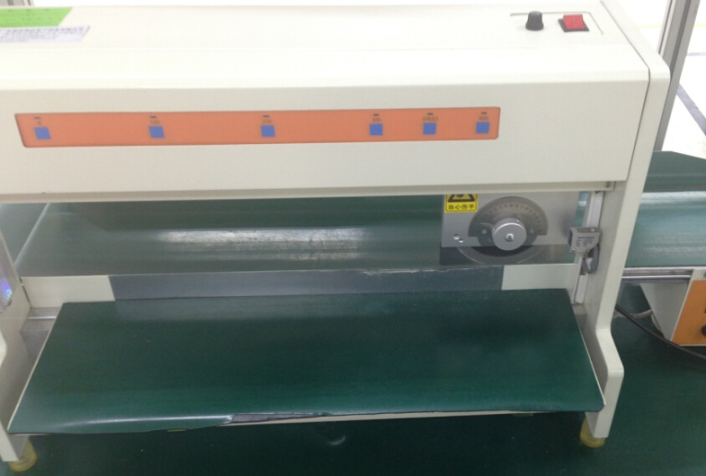
PCB layout rules
V-Cut VS Stamp layout :
  PCS to PCS distance only 0.3mm for V-Cut, we can save the PCB layout cost
  Stamp Cut design, PCB PCS to PCS distance is 2mm
  Base on same PCS design with different Cut type( stamp/V –Cut), the PCB cost will impact 10- 25%
  V-Cut PCB will be cut by machine, but Stamp Cut will broken by OP and have stress then damage the components
V-Cut machine

Slide 10
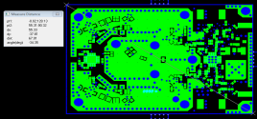
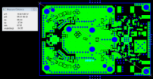

PCB/panel layout
Why don’t choose single PCB for SMT process :
  We need to put the each single PCB on carrier when do SMT process
  But carrier cave and single PCB have tolerance , so always happen solder paste printing misalignment then will get the shift/tombstone process issue
  Sometimes will happen single PCB lift up from SMT carrier and will have the chips mounting shift/missing process issues
PCB
Assembly Flow
Printer
SPI/VI
Mounter
Reflow oven
AOI
Put the single PCB on the carrier

Slide 11
PCB/panel layout
Factors of impact PCB Cost
  PCB layout
    Fine pitch components
    Panel V-Cut/Stamp Cut/PCB conveyor edge size
    PCB drill hole size/quantity
  PCB material cost
  PCB process easy/complicated , process spec
  PCB surface finished process also impact cost, OSP/IMS/EING/IMT
  PCB outline, regular shape is cheaper than irregular shape ,

Slide 12
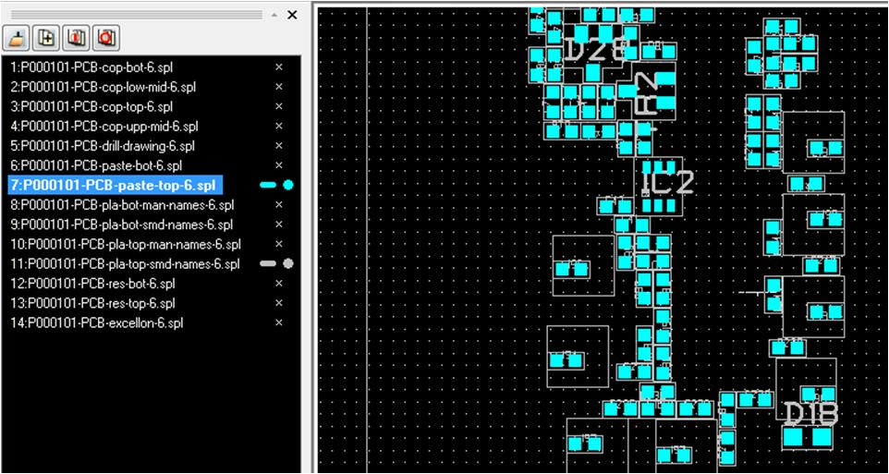
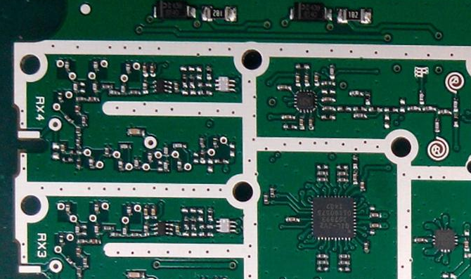
Text marking for silk layer
The current situation:
We received the gerber file for UK design team ,no silk layer be found
We can not directly confirm Polarity of component on the PCB , can not confirm the location of component ,easily to confirm IC shift or not .
In the production adjustment X, Y coordinate and confirmation the location completely rely on engineering drawings ,Big waste of time.
No silk layers in the gerber file
No text mark on the pcb

Slide 13
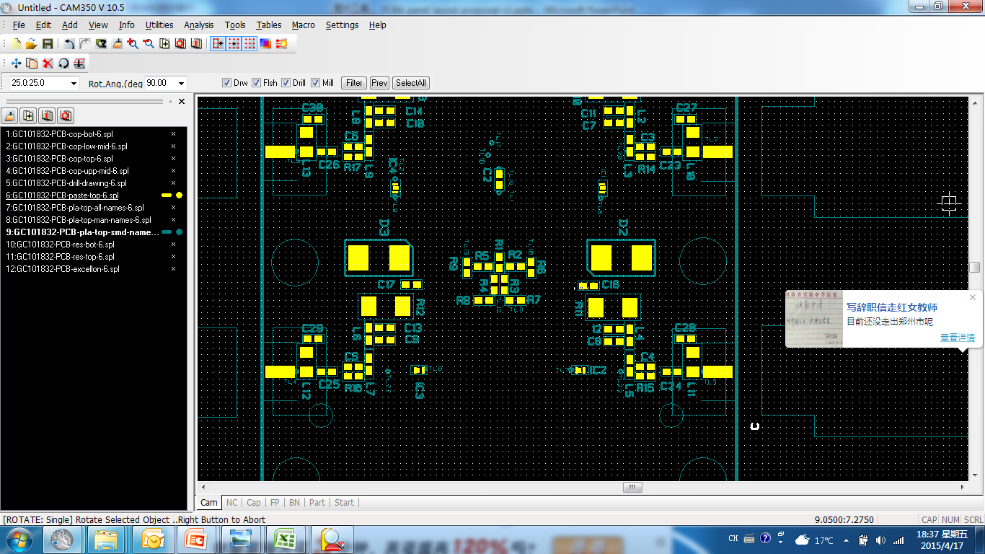
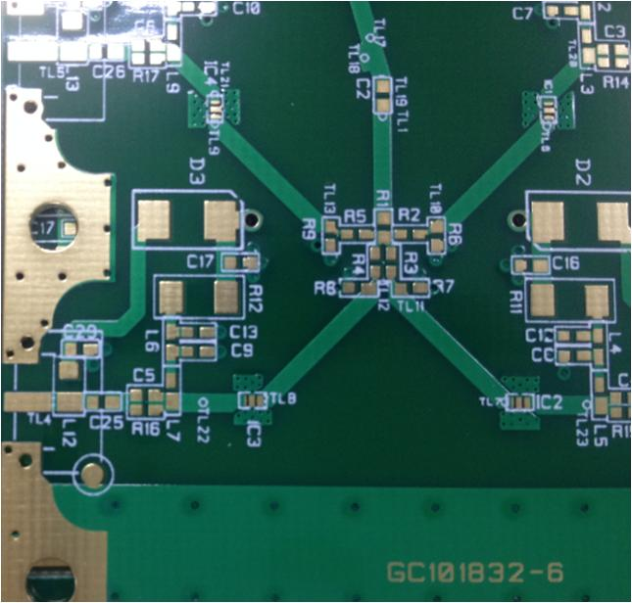
Text marking for silk layer
silkscreen
Text marking
As the icon text marking design we can accept . We can quickly inspection location where there are problems.

Slide 14
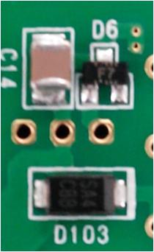
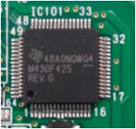
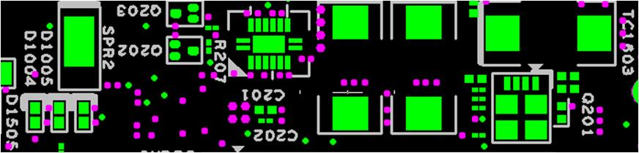
Text marking for silk layer
Component outline& polarity marking design definition:
    Text marking, keep away from Via Hole or Through Hole as far as possible
    Text marking , Silk screen printing character, polarity and polarity signs can not components be covered
    Text height≥25 mil ,line width ≥5 mil
    Beside the BGA/CSP ,component outline should not smaller than actual component size.
    The text does not overlap
    SMD/PTH component text marking include body outline , pin assignment ,component name ,polarity marking .as below:

Slide 15
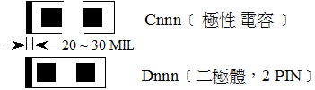
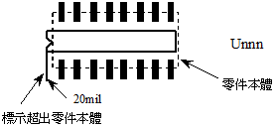
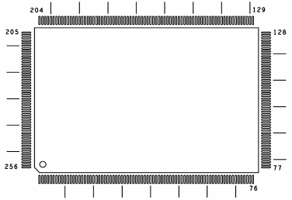
Text marking for silk layer
Component outline& polarity marking
  Tantalum capacitor or diode ﹝3 PIN﹞
  b.SOP/SSOP
  c. QFP

Slide 16
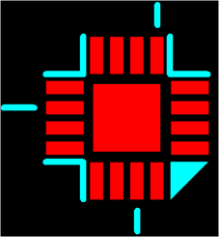
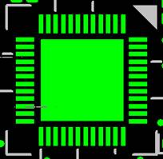
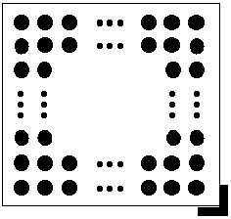
Text marking for silk layer
Component outline& polarity marking
  d. QFN
  e. BGA, CSP marking
  -. outline size must the same as actual component

Slide 17
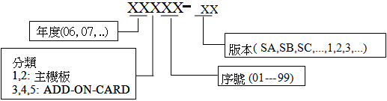
Text marking for silk layer
  PCB number and version
  (i) PCB Model
  (ii) PCB Part number and version
  (iii) text height : 80mil
  PCB 板號說明如下： 西元年度後兩碼 ( 06 , 07 )
  全新 PCB 必需附予板號及 -SA (Sample A) 版本，爾後修改版本依序為 -SB、-SC，或 -1A 、-1B 、-1C ...等，量產時版本必需為 -1、-2、-3等

Slide 18
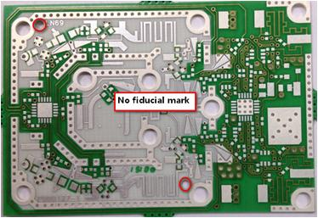
PCB Fiducial Mark design
The current situation: Many projects did not design fiducial mark-in, the machine can not recognize to position, cause no high precision print/mounted

Slide 19
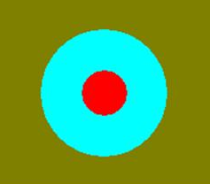
PCB Fiducial Mark design
≥4.0mm
Mark out
L
Mark in
D
d= 1.0mm
D=3.0mm
d
H
H≥L＋5.0mm
  Three fiducial mark-out located diagonally on board, and do follow related dimension requirement . fiducial mark dimension is 1mm(d) and solder mask is 3mm(D) . The diagonal fiducial mark should not be symmetrical, it should be keep away at 5 mm.
  Fiducial PAD edge keep 4mm distance from the edge of PCB
  Single board must have two fiducial mark –in located diagonally on the board.

Slide 20
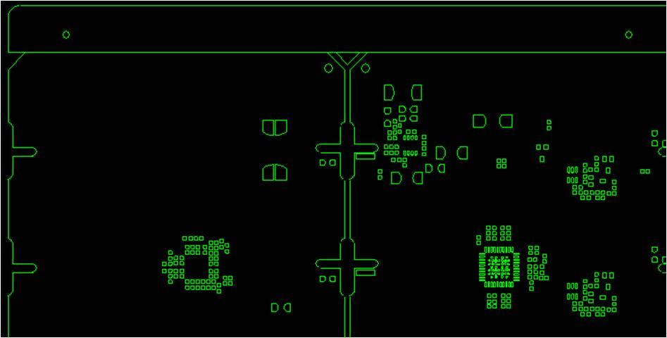
PCB fixed position hole
Tooling holes on all boards are called out with correct dimensions, tolerances, and are non-plated. ( 3.55mm +0.075/-0 or 2.18mm +0.05/-0.05)
There should be 3.81 mm arc located at 4 corners of PCB to avoid stuck at conveyor and damage of packing material.
Tooling holes
3.81 mm arc
Uniform fixed hole size and convenient tool for positioning

Slide 21
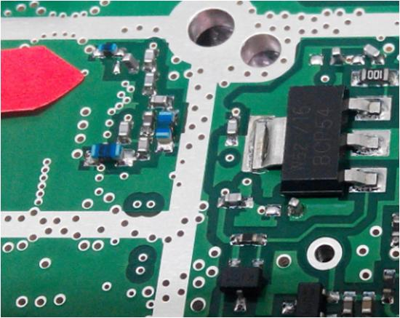
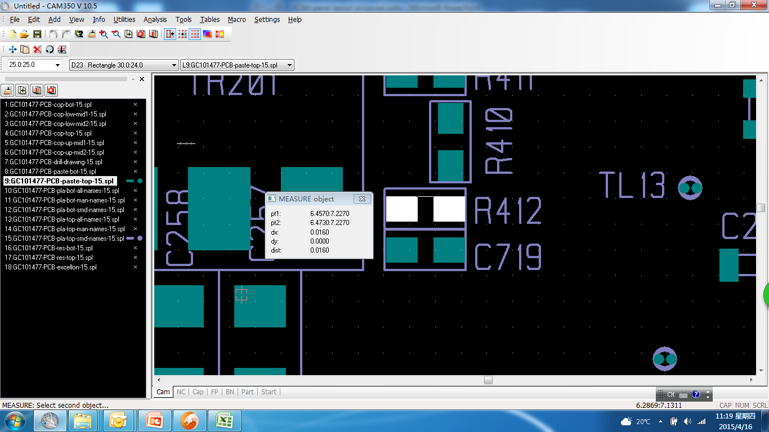
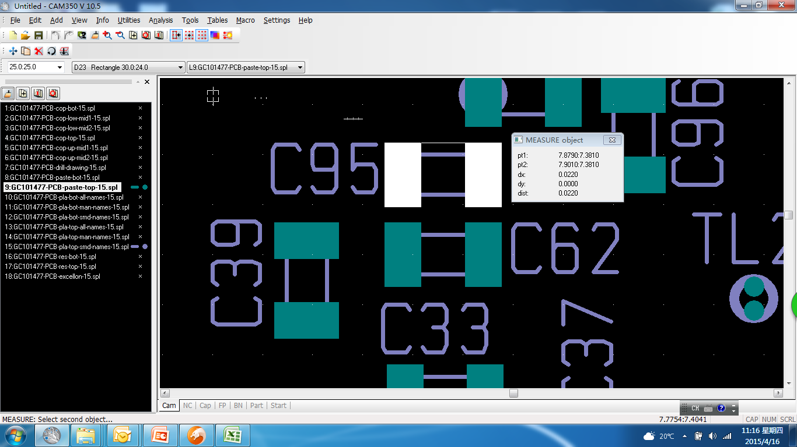
SMT component PAD design
  NG symptom: 0402 chip tombstone
  For example: D500+ FN700054 chip 0402 chip tombstone defect rate:1.0%
  NG picture:
Analysis: PAD to PAD space is too big caused the tombstone after IR .
PAD to PAD : 16mil
PAD to PAD : 22mil

Slide 22
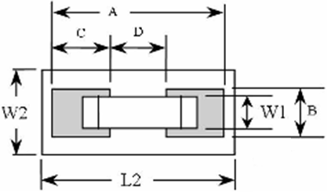
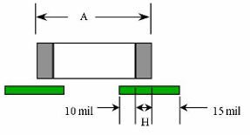
SMT component PAD design
Non specifications within RLC Pad design according to the following principles
  (i) B= max of W1, to prevent the shift
  (ii) C=10 + H(electrode width) + 15 mil
  (iv) restricted area L2: A+10mil ,W2=max: (" W1 + 8 + max of tolerance" , " B + 10 ")

Slide 23
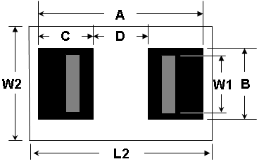
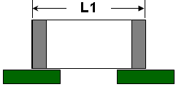
SMT component PAD design
36
8
12mil
0201 PAD design
14 mil
2mil fillet
57 mil
22 x 22 mil
4mil fillet
0402 PAD design
12 mil
Note: besides the chip 0201/0402,the rest of database is for reference only
(1) Resistance and inductance components size list
unit: mil
TYPE | Body Size(mil) |  | Component body tolerance(mm) | Pad Size(mil）
 | L1 | W1 |  | A | B | C | D
0201(0603) | 24 | 12 | ±0.03 | 36 | 12 | 14 | 8
0402(1005) | 40 | 20 | ±0.05 | 56 | 22 | 22 | 12
0603(1608) | 63 | 32 | ±0.1 | 83 | 40 | 31 | 21
0805(2125) | 79 | 50 | ±0.2 | 103 | 61 | 37 | 29
1206(3216) | 123 | 63 | ±0.25 | 160 | 73 | 50 | 60
1210(3225) | 123 | 101 | ±0.2 | 171 | 110 | 55 | 61
2010(5025) | 197 | 99 | ±0.25 | 230 | 110 | 45 | 140
2512(6432) | 252 | 126 | ±0.25 | 290 | 138 | 70 | 150
ref. | L2=A + 10；W2=max: (" W1 + 8 + max of tolerance " , " B + 10 ")

Slide 24
SMT component PAD design
(2) capacitance component size list
Note: besides the chip 0201/0402,the rest is for reference only
unit: mil
TYPE | Body Size(mil) |  | Component body tolerance (mm) | Pad Size(min) |  |  |  | Placement Size |  | area
 | L1 | W1 |  | A | B | C | D | L2 | W2
0201(0603) | 24 | 12 | ±0.03 | 36 | 12 | 14 | 8 | 51 | 22 | 1122
0402(1005) | 40 | 20 | ±0.05 | 56 | 22 | 22 | 12 | 75 | 34 | 2550
0402(1005) | 40 | 20 | ±0.1~0.2 | 60 | 28 | 24 | 12
0603(1608) | 63 | 32 | ±0.2 | 83 | 40 | 31 | 21 | 105 | 46 | 4830
0805(2125) | 79 | 50 | ±0.25 | 103 | 61 | 37 | 29 | 140 | 76 | 10640
1206(3216) | 126 | 63 | ±0.3 | 160 | 73 | 50 | 60 | 182 | 86 | 15652
1210(3225) | 126 | 99 | ±0.3 | 171 | 110 | 55 | 61 | 190 | 130 | 24700
1808(4520) | 189 | 80 | ±0.3 | 210 | 90 | 50 | 110 | 230 | 120 | 27600
1812(4532) | 182 | 126 | ±0.3 | 207 | 136 | 60 | 87 | 237 | 166 | 39342
ref. | L2=A + 10；W2=max: (" W1 + 8 + max of tolerance " , " B + 10 ")

Slide 25
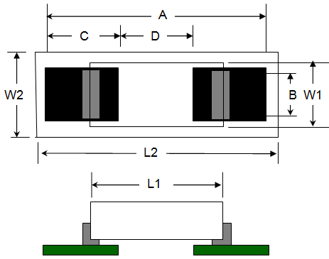
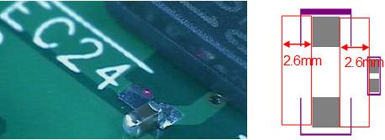
SMT component PAD design
(3) STC3216~7343
unit: mil
TYPE | Body Size |  | Pad Size |  |  |  | Placement Size |  | area
 | L1 | W1 | A | B | C | D | L2 | W2
3216 | 124 | 66 | 176 | 66 | 50 | 76 | 227 | 112 | 25424
3528 | 142 | 113 | 240 | 90 | 90 | 60 | 283 | 164 | 46412
6032 | 232 | 130 | 334 | 105 | 90 | 154 | 380 | 180 | 68400
7343 | 282 | 173 | 338 | 95 | 90 | 158 | 390 | 200 | 78000
ref. | L2=A + 30；W2=component body width+ 20；D=A - 2 x C;
Note : No chips component that size below 0603 located beside 7347 and 6032 tantalum capacitor within 2.6mm pad to pad distance. If un-avoidable, the chip components should be vertical with the tantalum capacitor.

Slide 26
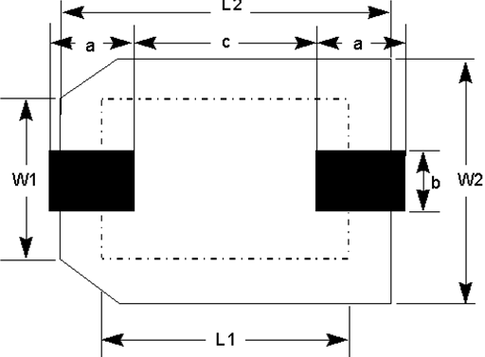
SMT component PAD design
(4)Electrolysis capacitor parts size list
unit:mm
TYPE | Body Size |  | Pad Size |  |  | Placement Size
 | L1 | W1 | a | b | c | L2 | W2
SE3116 | 8.0 | 6.3 | 3.1 | 1.6 | 2.2 | 9.4 | 7.0
SE2811 | 6.3 | 5.0 | 2.8 | 1.6 | 1.4 | 8.0 | 5.7
SE2716 | 6.0 | 5.0 | 2.7 | 1.6 | 1.4 | 7.8 | 5.7
SE2516 | 5.5 | 4.0 | 2.5 | 1.6 | 1.0 | 7.0 | 4.7

Slide 27
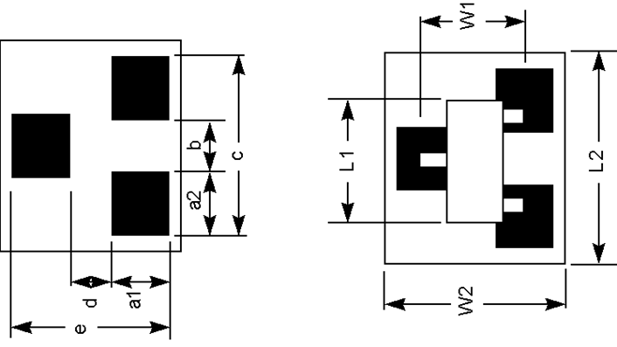
SMT component PAD design
  (5)Diode-3PIN
unit: mil
TYPE | Body Size |  | Pad Size |  |  |  |  |  | Placement Size
 | L1 | W1 | a1 | a2 | b | c | d | e | L2 | W2
SOT-23 |  |  | 48 | 40 | 40 | 120 | 40 | 136 | 136 | 156
Diode-3PIN |  |  | 48 | 40 | 40 | 120 | 40 | 136 | 136 | 156
ref. | W2=e+20 , L2=max(c+16; L1+16)
a1 = (e-d) / 2
A2
a2 =A2+6
A3
B
a3 =A3+6
b = B-A2-6
A1
d = D+6
e = E+30
8mil R角
A1
D
E

Slide 28
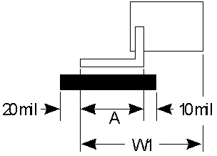
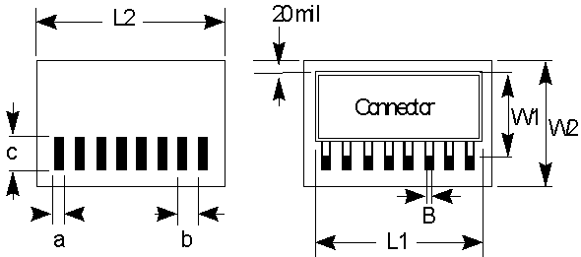
SMT component PAD design
  (6) Connector pin for Single side
unit: mil
Pitch, b |  | Body Size |  | Pad Size |  | Placement Size
(mm) | (mil) | L1 | W1 | a | c | L2 | W2
0.5 | 19.685 |  |  | 12 | A+30 | L1+30 | W1+50
0.635 0.650 | 25.00 25.59 |  |  | 14 | A+30 | L1+30 | W1+50
>0.65 | >25.59 |  |  | B+4 | A+30 | L1+30 | W1+50
Note |  | * If the component pitch be defined by the metric unit , In English units should be considered for the calculation of the cumulative error of Pitch *The distance between connectors should at least have 2mm space from the outline edge of the Pad or Body. *For component higher than 5mm, need to keep same distance/clearance on pcb surface free from component to avoid shadow effect and causing AOI limiation. *The distance between smd type connector and chip should at least have 2mm space from the outline edge of the Pad or Body. *Boss pin hole size (NPTH) = Connector boss size + 0.15 mm

Slide 29
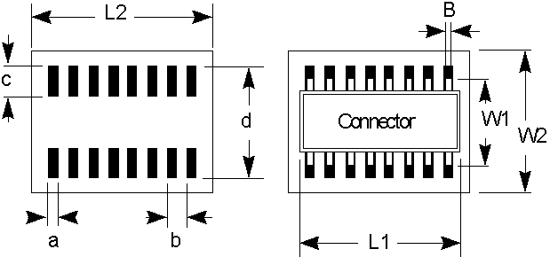
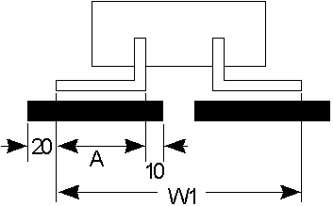
SMT component PAD design
  (7)Connector pin for two side
unit: mil
Pitch, b |  | Body Size |  | Pad Size |  |  | Placement Size
(mm) | (mil) | L1 | W1 | a | c | d | L2 | W2
0.5 | 19.685 |  |  | 12 | A+30 | W1+40 | L1+30 | d+30
0.635 0.650 | 25.00 25.59 |  |  | 14 | A+30 | W1+40 | L1+30 | d+30
>0.65 | >25.59 |  |  | B+4 | A+30 | W1+40 | L1+30 | d+30
Note |  | * If the component pitch be defined by the metric unit , In English units should be considered for the calculation of the cumulative error of Pitch *The distance between connectors should at least have 2mm space from the outline edge of the Pad or Body. *For component higher than 5mm, need to keep same distance/clearance on pcb surface free from component to avoid shadow effect and causing AOI limiation. *The distance between smd type connector and chip should at least have 2mm space from the outline edge of the Pad or Body.

Slide 30
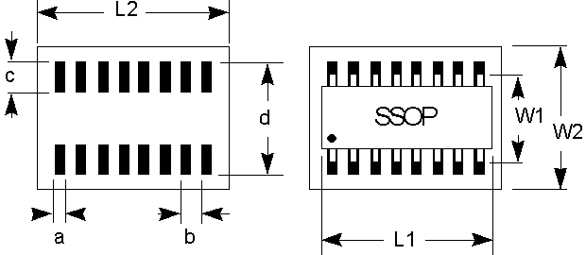
SMT component PAD design
(8)IC types
  a. SSOP, SOP
unit: mil
Type | Pitch, b |  | Body Size |  | Pad Size |  |  | Placement Size
 | (mm) | (mil) | L1 | W1 | a | c | d | W2 | L2
SSOP | 0.4 | 15.748 |  |  | 8 | 60 | W1+30 | d+30 | L1+20
SSOP | 0.5 | 19.685 |  |  | 12
SSOP | 0.635 | 25 |  |  | 14
SSOP | 0.65 | 25.59
SSOP | 0.8 | 31.496 |  |  | 16
SOP | 1.27 | 50 |  |  | 25
 | Note |  | * If the component pitch be defined by the metric unit , In English units should be considered for the calculation of the cumulative error of Pitch

Slide 31
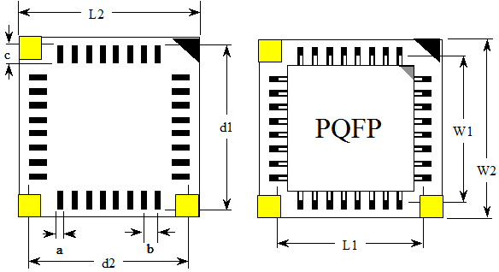
SMT component PAD design
(8)IC types
b.QFP
unit: mil
Pitch | Body Size |  | Pad Size |  |  |  | Placement Size
b | W1 | L1 | a | c | d1 | d2 | W2 | L2
19.485 (0.5mm) |  |  | 12 | 60 | W1+40 | L1+40 | d1+20 | d2+20
25.59 (0.65mm) |  |  | 16 | 90 | W1+50 | L1+50 | d1+20 | d2+20
31.496 (0.8mm) |  |  | 18 | 90 | W1+50 | L1+50 | d1+20 | d2+20
Note | If the component pitch be defined by the metric unit , In English units should be considered for the calculation of the cumulative error of Pitch

Slide 32
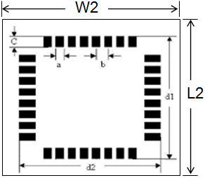
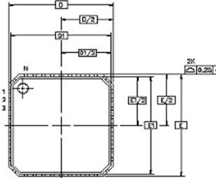
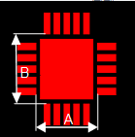
SMT component PAD design
IC types
  (9)QFN
unit: mil
Pitch | Body Size |  | Pad Size |  |  |  | Placement Size
b | D | E | a | c | d1 | d2 | L2 | W2
19.485 (0.5mm) |  |  | 12 | 60 | E+40 (On both sides of the 20 ) | D+40 (On both sides of the 20 ) | d1+30 | d2+30
25.59 (0.65mm) |  |  | 14 | 60 | E+40 (On both sides of the 20 ) | D+40 (On both sides of the 20 ) | d1+30 | d2+30
Note | Ground pad at the bottom of the QFN : A - D2 >= 0.4 mm; B - E2 >= 0.4 mm

Slide 33
SMT component PAD design
  BGA, CSP
unit: mil
Pitch ,b |  | Body Size |  |  | Pad Size | Placement Size
(mm) | (mil) | L1 | W1 |  | a | L2 | W2
CSP |  | <= 5 mm |  | <= 5mm |  | L1+80 | W1+80
BGA |  | > 5mm |  | > 5mm |  | L1+120 | W1+120
Note |  | *Don't overlap with any component. *Don't put the range of Connector, BGA and other large easy to heat parts. All of the Via Hole shall be double coverage of solder mask layers

Slide 34
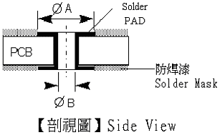
PTH component PAD design
  In order to simplify and improve the printing circuit welding (soldering) process , The special development of through-hole reflow technology (Pin-in-Paste) The through-hole type connector from Dipping process ,change to SMT printing solder paste and reflow replaced . Place all thru-hole parts on topside of the board. (Avoid manual soldering process)
  B : aperture size≧pin diameter size +0.25 mm ( 10 mil )
  A : The outer layer of the minimum pad size ≧ aperture size+ 0.36 mm (14 mil )
  According to the manual soldering parts : Pad size (ΦA) = Hole size (ΦB) + 40 mil

Slide 35
PTH component PAD design
  PTH design guideline
  Parts of pin diameter and through the aperture ratio (PH) principle:
  Pin to hole rate (ØP / ØH) should fall within 0.6~0.8, shown as diagram:
  PH= 0.6~0.8 the best ; PH= 0.4~0.5 Acceptable ; PH < 0.3 not acceptable

Slide 36

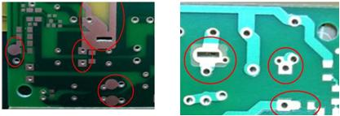
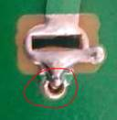
PTH component PAD design
  If any annular ring of PTH connect with connector or PTH pad, please add solder mask to isolate each other (width 20mil at least).
As PSU A000116 Design issue, between PAD with Ground no solder mask covered cause the solder bridge /empty solder.

Slide 37
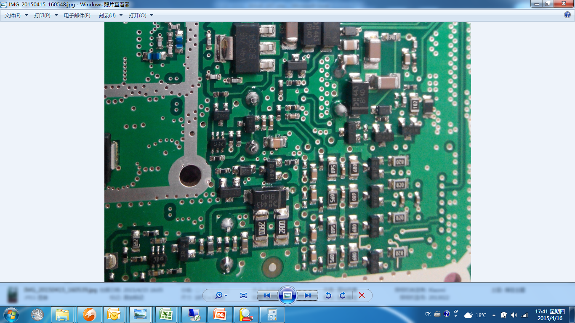
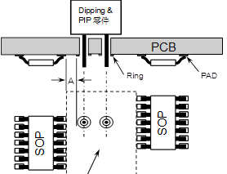
PTH component PAD design
The distance between the PTH and chips too is very close when manual solder has the risk for broken and solder short . besides arrange Ops to manual solder ,no choice, Waste a lot of manpower and delay output
PTH restricted zone:
For pin in paste process, keep at least 3mm distance between edge of hole ring and pad.

Slide 38
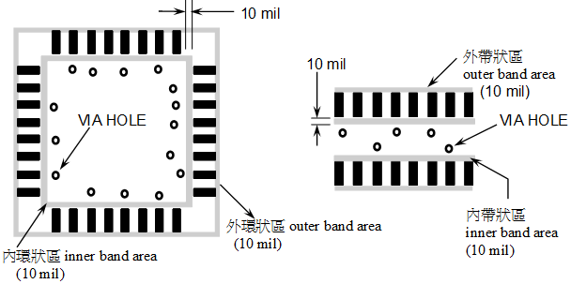
Through-hole(Via)design
Via hole under the component body
Via hole under the smt component body ,need to confirm this PCB whether through wave soldering process ,if so, need to blind and buried via hole. Otherwise, there will be the risk of overflow from the hole of Via solder.
  (1) The normal PAD layout (Within the PAD pins )
  ‧ Inner band area (10mil) Via Hole can not be placed.
  ‧ outline band area(10mil) ,Via Hole can not be placed.

Slide 39
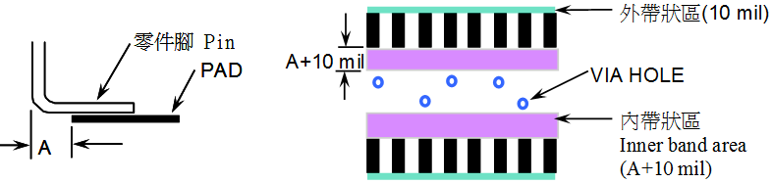
Through-hole(Via)design
Via hole under the component body
  (2) Un-normal PAD layout ( the pin of the component over the PAD )
  ‧inner band area (A + 10mil ) Via Hole can not be placed
  ‧outline band area (10mil ) Via Hole can not be placed

Slide 40
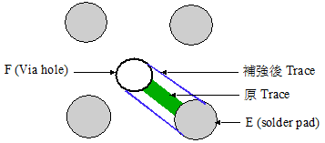
Trace design
Power Trace to strengthen
  PAD/Via hole with Trace to junction need to strengthen，the general way (Power Trace，the rest of type refer to Tear drop design)

Slide 41
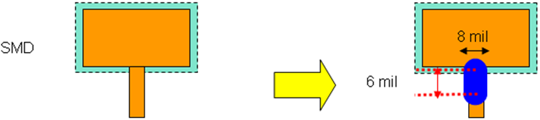


Trace design
Add tear drop
  In the outer trace add tear drop as below icon:
  (1) When the line width is less than 8 mil ,In pad and trace junction with width of 8 mil and length of 6 mil trace .
  (2) When the line width is more than 8min,do not add Tear Drop
  (3) If the distance is not enough to add a Tear Drop, can be ignored.

Slide 42
Trace design
Trace lead the way
Keep symmetric trace design
symmetric
asymmetric
Trace from the center of the pad
trace
PAD

Slide 43
Trace design
Trace line and the hole,be recommended in the following.
Filleting
Corner Entry
Key Holing

Slide 44
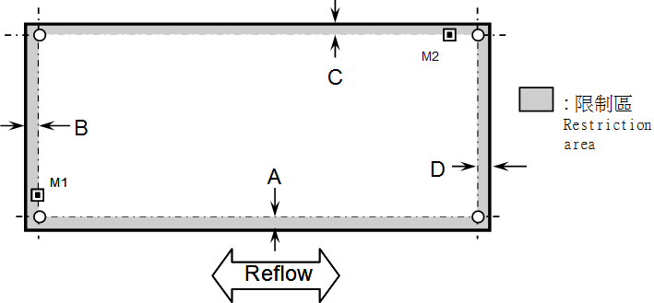
Other limitation
Component placement limitation
Board edge parts restriction (including the process edge size)
  (i) In SMT stage, there should be no any component body or pad within 4 mm along pcb edge that used for conveyor transfer.(as below the upper and the lower sides), Within 2 mm from pcb edge that vertical to the conveyor. PIP or PTH component body should not out of pcb edge.

Slide 45

Other limitation
  Component placement limitation
  Board edge parts restriction (including the process edge size)
  (ii) In SMT stage, the component height should lower than 2 mm when it away from pcb edge 4~6mm ( indicated in pink color region).

Slide 46

Other limitation
Deformation limit
  B/A≤7.5/1000, and the maximum deformation of B must be less than 1.2 mm
  PCB thickness limit: 1 ~ 1.6 ± 0.127 mm or 10%
PCB substance selection
    The pcb prepreg should meet criteria of Tg ≧145℃.
    The pcb prepreg should meet criteria of Td>320 ℃.

Slide 47

Other limitation
  PIP parts limit
  All of the through hole part must be designed in second to avoid the use of hand soldering process The first surface is necessary to use the SMD TYPE part or through hole parts pin and parts body can not outstand PCB second surface
  The spec of pin out of pcb surface in PIP process :
  pin length ≒ PCB thickness + 0.3~0.6 mm
  The insert parts in PCB can not tilt, dumping or easy to loose state.

Slide 48











Other limitation
Choose the component :The use of chip components in the SMT stage as far as possible, reduce the waste of human action.
PTH parts to SMD
PTH parts to SMD
PTH parts to SMD
PTH parts to SMD

Slide 49


Other limitation
No trace cutting or jump wires process on mass production models.
Jump wires
Cut trace

Slide 50


Other limitation
PCB pad size should be match with the size of components , If the same parts have different appearance size ,the Layout or according to process proposals to special Layout, must conform the rule。All of pad design need to non-solder mask design.
  Passive component pad size
  The general RLC component： place outline area do not overlap

Slide 51

Other limitation
For component higher than 5mm, need to keep same distance/clearance on pcb surface free from component to avoid shadow effect and causing AOI limiation.
D = H

Slide 52

Gerber file layers requirement
SMD layer: component PAD , reference this layer to design stencil aperture

Slide 53


Gerber file layers requirement
Silk layer: SMD component text marking include body outline , pin assignment ,component name ,polarity marking

Slide 54

Gerber file layers requirement
Solder mask layer

Slide 55

Gerber file layers requirement
Place layer :check the component location

Slide 56

Gerber file layers requirement
Drill layer :confirm the through-hole size whether it match with the component

Slide 57

Thank You !

